Slide 1
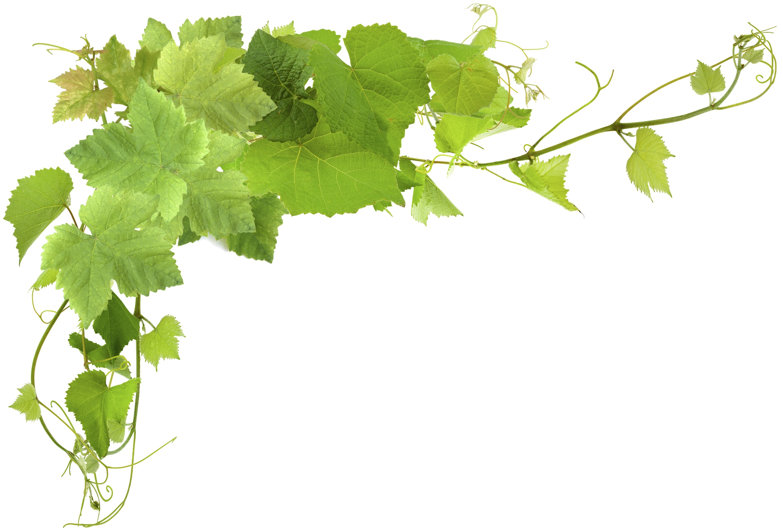


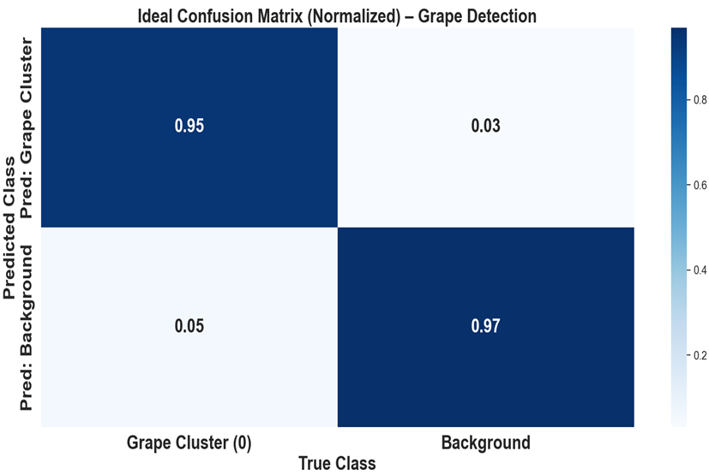
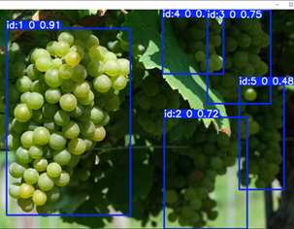
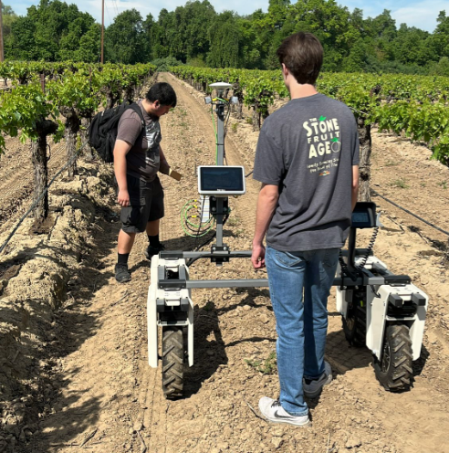
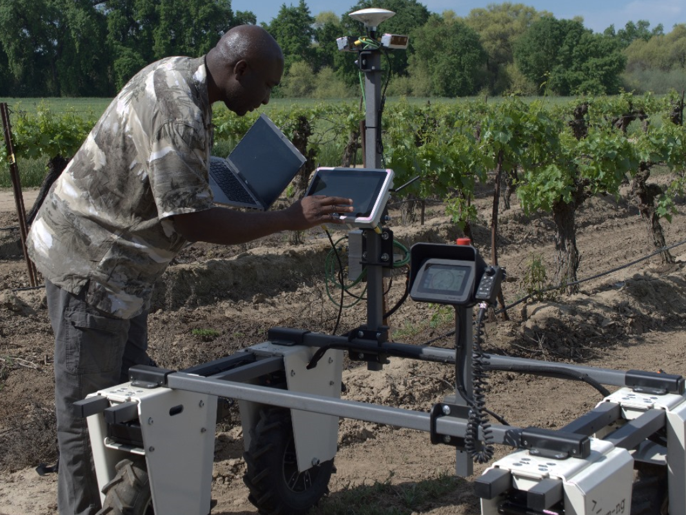
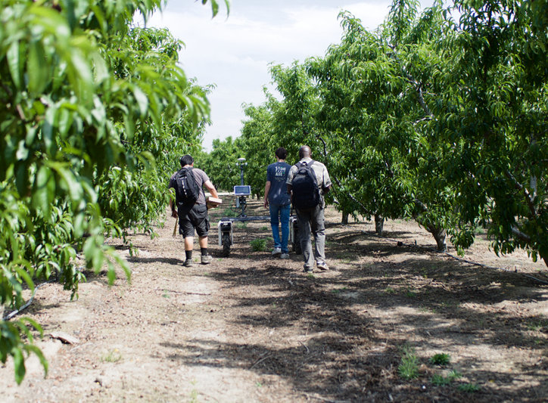


Fruit Cluster Detection and Counting using Amiga Robot and YOLO Models
Abioye E. Abiodun, Jesus, Tadeo Vargas, Baltazar Pacheco Hernandez, Cole Diquirico, Juan Heredia, Valaria Magana, Tanner Drake Jones, Gabriella Garcia, David Clark, Allen Vizcarra, John Heathcote and Simon Sultana Reedley College, 995 N. Reed Ave. Reedley, CA 93654
*lucabrillante@csufresno.edu
Abstract
Results
Accurate and efficient monitoring of fruit clusters is essential for yield estimation and vineyard management, yet traditional manual methods are time-consuming and error-prone. This study presents a student-led approach to automate fruit cluster detection, tracking, and counting using the Amiga robot and YOLO (You Only Look Once) object detection model. The Amiga robot, equipped with a vision system and autonomous navigation capabilities, was deployed in both vineyard and lab environments. Images of fruit clusters were collected, annotated using Roboflow, and used to train YOLOv8 model. The trained models were integrated into the robot’s onboard system to enable real-time inference. Results showed that YOLOv8 provided the best balance between speed and accuracy, achieving an F1 score of 0.93 at a confidence threshold of 0.488 and a mean Average Precision (mAP) of 0.965 at IoU 0.5. This project highlights the feasibility of combining robotics and AI for precision agriculture and serves as an educational tool for students in STEM fields, offering hands-on experience in deploying intelligent systems in real-world agricultural applications.
Materials & Methods
This normalized confusion matrix shows that the fruit detection model correctly identifies 95% of fruit clusters and 97% of background instances.
Platform: The Amiga robot from Farm-ng was used, featuring an onboard camera system, autonomous navigation, and AI integration capabilities.
Data Collection: Images of fruit clusters were captured both in the Reedley College vineyard and Moon light stone fruit orchard.
Annotation: The images were annotated using Roboflow, with bounding boxes around fruit clusters. The dataset was divided into training, validation, and test sets.
Model Training: YOLOv8 model were trained using Google Colab Pro with GPU acceleration, applying consistent hyperparameters for fair evaluation.
Deployment: The trained models were integrated into the Amiga robot using the Docker Container, enabling real-time detection and counting.
Navigation: The robot’s movement was automated using the Track Planner and Track Follower modules, allowing it to follow predefined vineyard paths during operation.
Problem Statement
Manual methods of monitoring fruit clusters such as counting and assessing them by human labor are time-consuming, inconsistent, and prone to errors.
These traditional approaches limit the efficiency and accuracy of yield estimation in fruit farming.
With the growing demand for precision agriculture, there is a need for an automated, reliable solution to detect, track, and count fruit clusters in real-time field conditions.
Fig. 1 The experimental sites in Reedley College Vineyard
Objectives
Configure the Amiga robot’s camera system to collect high-quality images of fruit clusters.
Develop and annotate a dataset using vineyard and lab-based images for model training.
Train and evaluate YOLOv8 model for fruit cluster detection.
Integrate the best-performing YOLOv8 model with the Amiga robot for real-time inference.
Implement autonomous navigation to allow the robot to operate independently in vineyard rows while tracking and counting fruit clusters.
YOLOv8 delivered the best balance between speed and accuracy, achieving: F1 Score: 0.93 at a 0.488 confidence threshold, Mean Average Precision (mAP): 0.965 at IoU 0.5
Conclusion
The detection and counting model were successfully integrated with the Amiga robot, enabling real-time tracking and counting of fruit clusters
The system demonstrated high precision and accuracy, demonstrating its usefulness in both vineyard and lab settings.
Fig. 2: Experimental Sites at Moonlight Stone fruit Orchard
We are grateful to the funding agencies of this project:

